Slide 1
Cookbook for Practice 5.2
实践5.2攻略
Cong Li 李聪

Slide 2

Data for One vs. Rest
一对其余的数据 (1)
In the file ‘perceptron.py’, create a class, ‘BinaryData’, for data used in one vs. rest. In its initialization, pass in the original data & the current class label of interest, & store them in member variables
在文件“perceptron.py”中，创建“BinaryData”类型，并在其初始化函数中接受原来的数据和当前关注的类别标记，存储于成员变量中

Slide 3

Data for One vs. Rest
一对其余的数据 (2)
Now we write the 3 member functions to get data size, the attributes of a data sample, & the its class label. Reuse the original data’s member functions for the first two.
现在我们来写获取数据数量、某个数据的属性及其类别标记的3个成员函数。对前两个，直接调用原来的数据的对应成员函数

Slide 4

Data for One vs. Rest
一对其余的数据 (3)
For the member function to get the class label of the data sample, compare the label w/ the label of interest, & then return 1 or -1 for the one or the rest
对于获得某数据类别标记的成员函数，比较其标记和当前关注的标记，返回1或-1，表示一或其余

Slide 5

Multi-class Perceptron
多类感知器 (1)
In the same file, create a class of ‘Perceptron’ for multi-class perceptron. Similar to ‘BinaryPerceptron’, take a input parameter for maximum number of rounds in training
在同一个文件中，为多类感知器创建类型“Perceptron”。和 “BinaryPerceptron”类似，在其初始化函数中接受一个最大训练轮数的参数

Slide 6
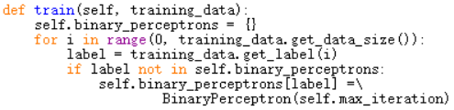
Multi-class Perceptron
多类感知器 (2)
To train a multi-class perceptron, we need to figure out how many unique classes there are in the training data. We use a dictionary to associate each class label w/ a binary perceptron
为了训练多类感知器，我们需要知道训练数据中一共有多少不同的类别。我们用一个字典，为每种类别标记关联一个两类感知器

Slide 7

Multi-class Perceptron
多类感知器 (3)
For each class label, we create data for one-vs.-rest, & train the binary perceptron
对每种类别，我们创建一对其余的数据，并训练两类感知器

Slide 8
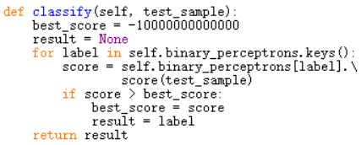
Multi-class Perceptron
多类感知器 (4)
During classification, we loop over all those binary perceptrons to generate scores, & find the one w/ the best score
在分类时，我们遍历所有的两类感知器来获取得分，最终选择得分最高的

Slide 9
Run It 运行之
Based on Practice 4.4, in file ‘test.py’, now import ‘perceptron’ & create the instance of the ‘Perceptron’ class for classification
基于实践4.4，在文件“test.py”中，导入“perceptron”，创建“Perceptron”类型的实例，进行分类
Run it 运行之

Slide 10
The End

